Slide 1
Supervised Learning: Case Study 3
Re: Cell Problem Statement
By
Nafis Zafar

Slide 2

Agenda
Business Overview and approach to the solution
Data Overview, Key Finding and Insights
Business Recommendations
Explanation of Key Takeaways
Benefit of Implementing the solution

Slide 3

Business Overview and Approach to Solution
Due to rising demands of refurbished cell phones the industry has recently seen significant growth. The industry is estimated at 52 billion dollars by 2023.
Due to high price of new phones consumers are leaning toward used phones which is also better for environment.
The industry is growing at 13% rate since 2018 to 2023.
As a Recell data scientist I have analyzed the data to understand the key factors that determine the price of a refurbished phone.
As a data scientist I will recommend pricing of various models of cell phones using a ML based linear regression model.

Slide 4
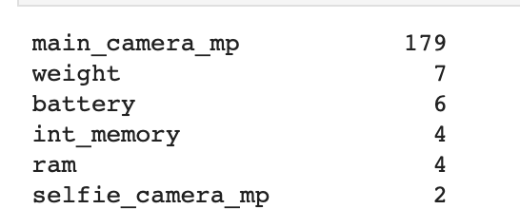
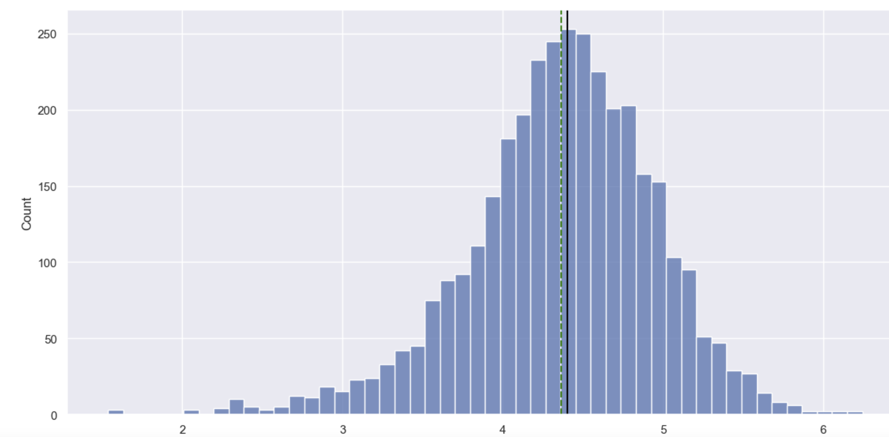
Data Overview, Key Finding and Insights
We have observed 3454 records for data overview
We observed some missing values for some data points (SC1)
Normalized used price is much better (4.3) than the normalized new price (5.2) and more linear (SC2)

Slide 5
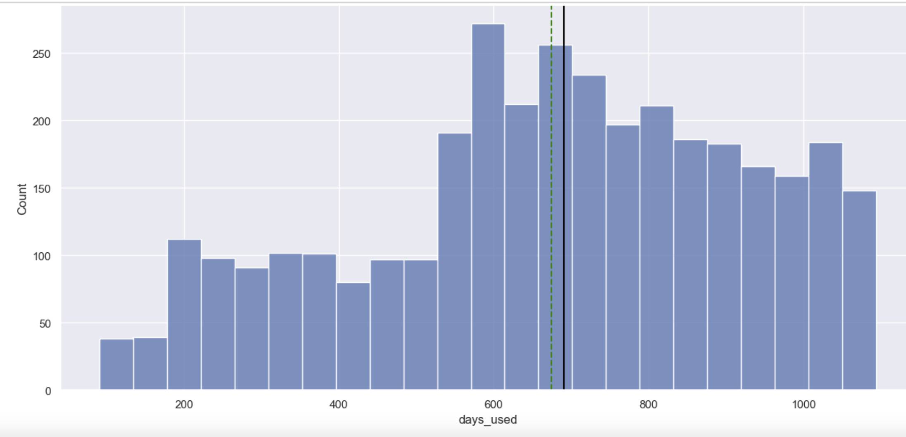
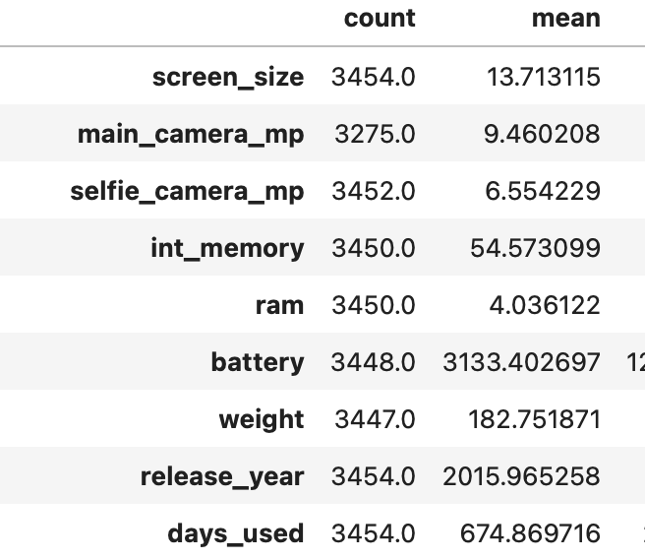
Data Overview, Key Finding and Insights
Here are the average of key metrics:
Most popular screen_size is 15.3
Most popular memory size is 64
Most popular camera for front and back is 13 and 8 respectively
Majority of the phones are from 2018
A lot of users have held on to the phone for 868 days

Slide 6
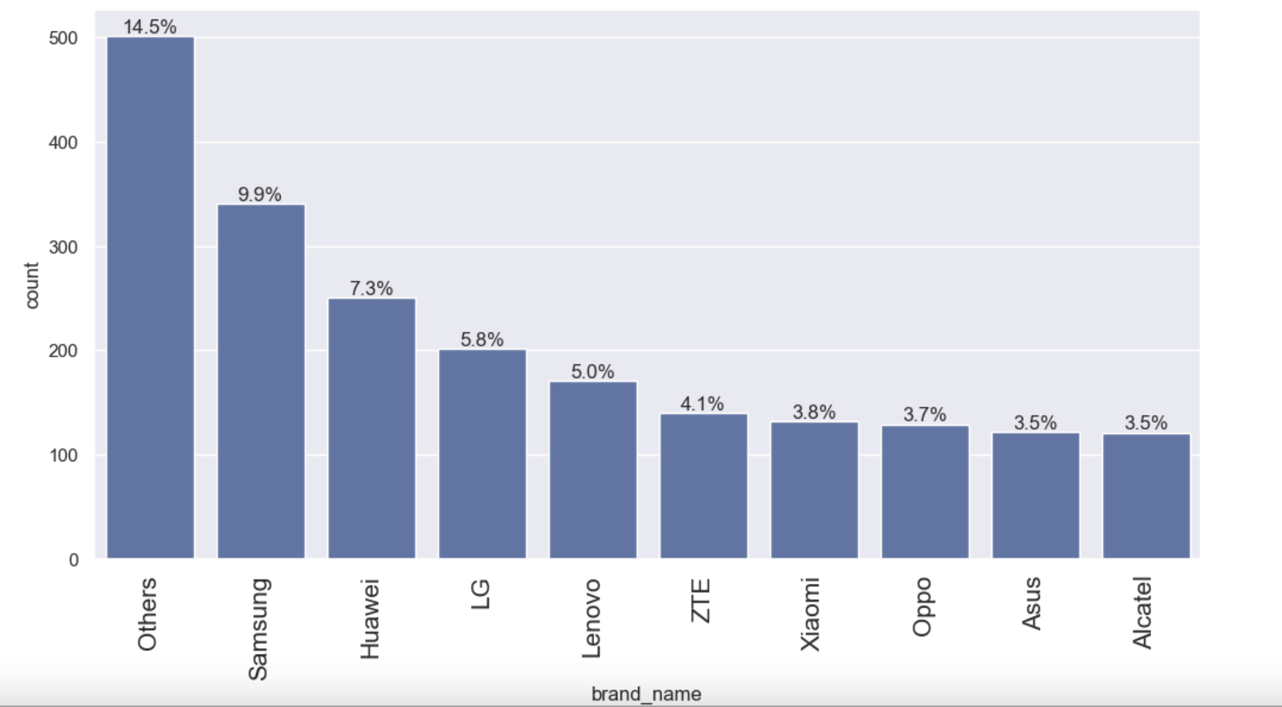
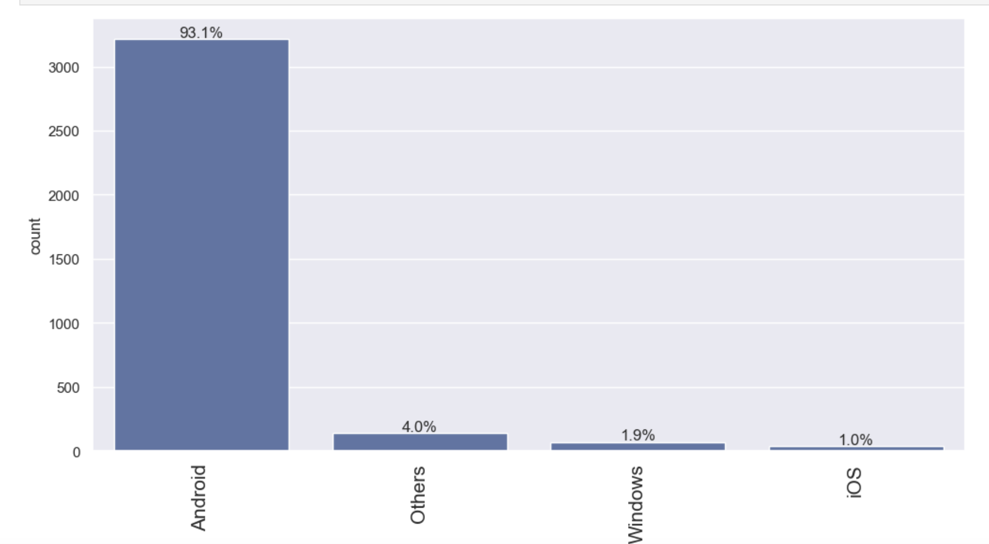
Data Overview, Key Finding and Insights
Most popular known Brand is Samsung
Overwhelming amount of majority uses Android phones

Slide 7
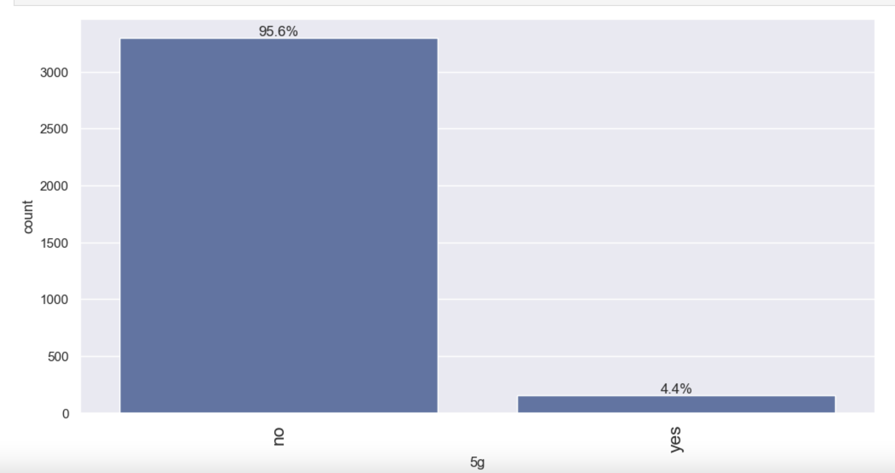
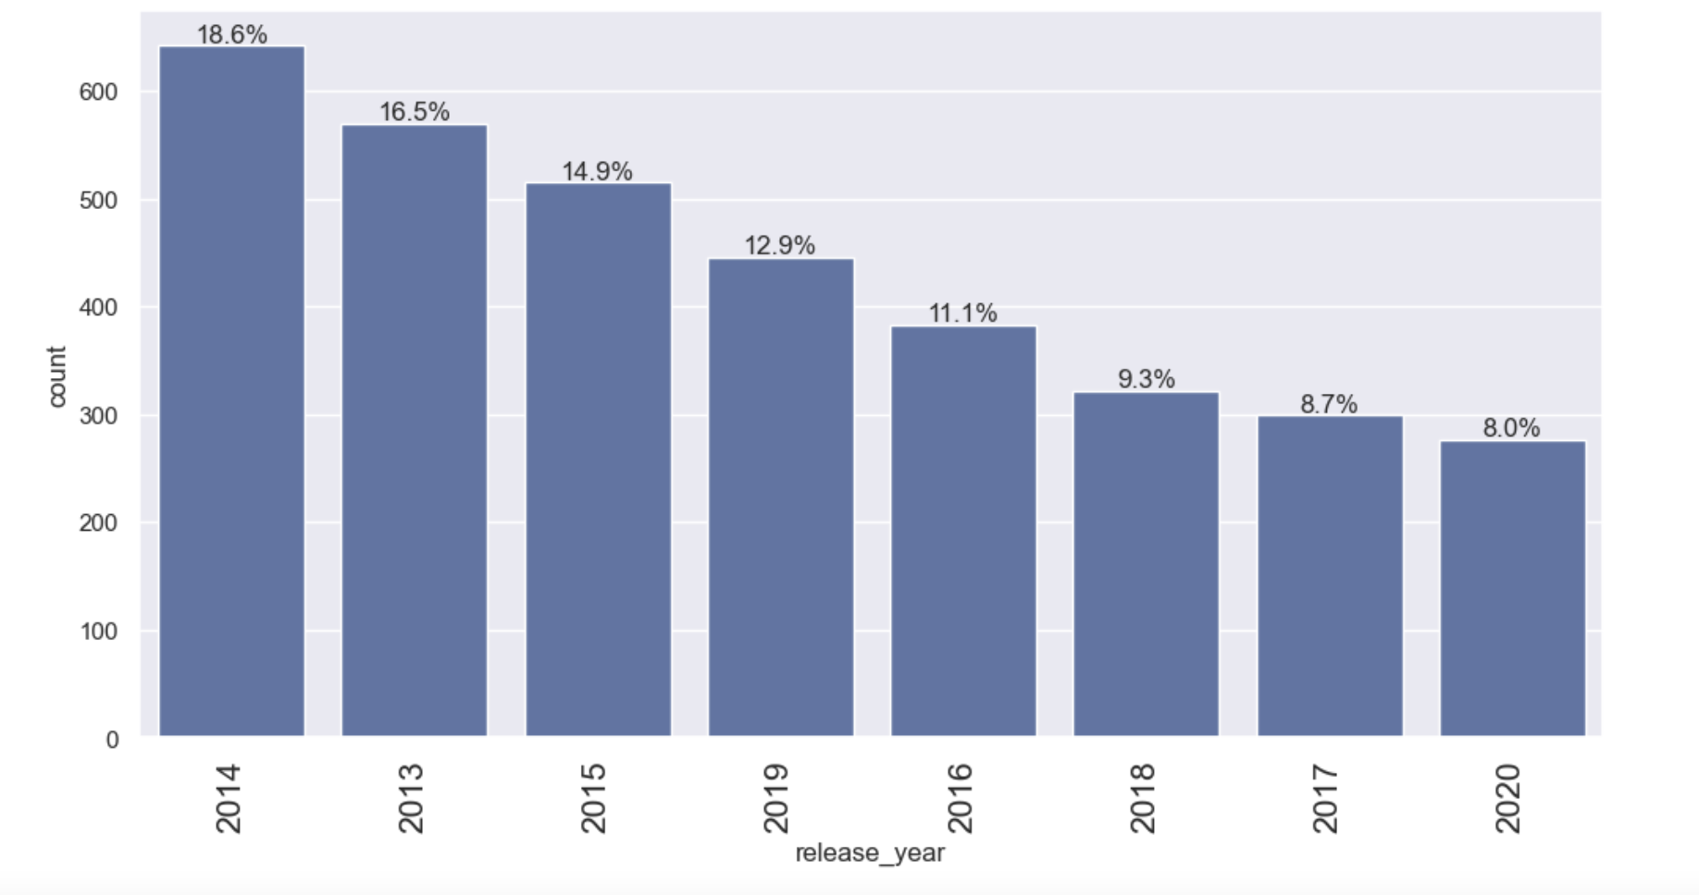
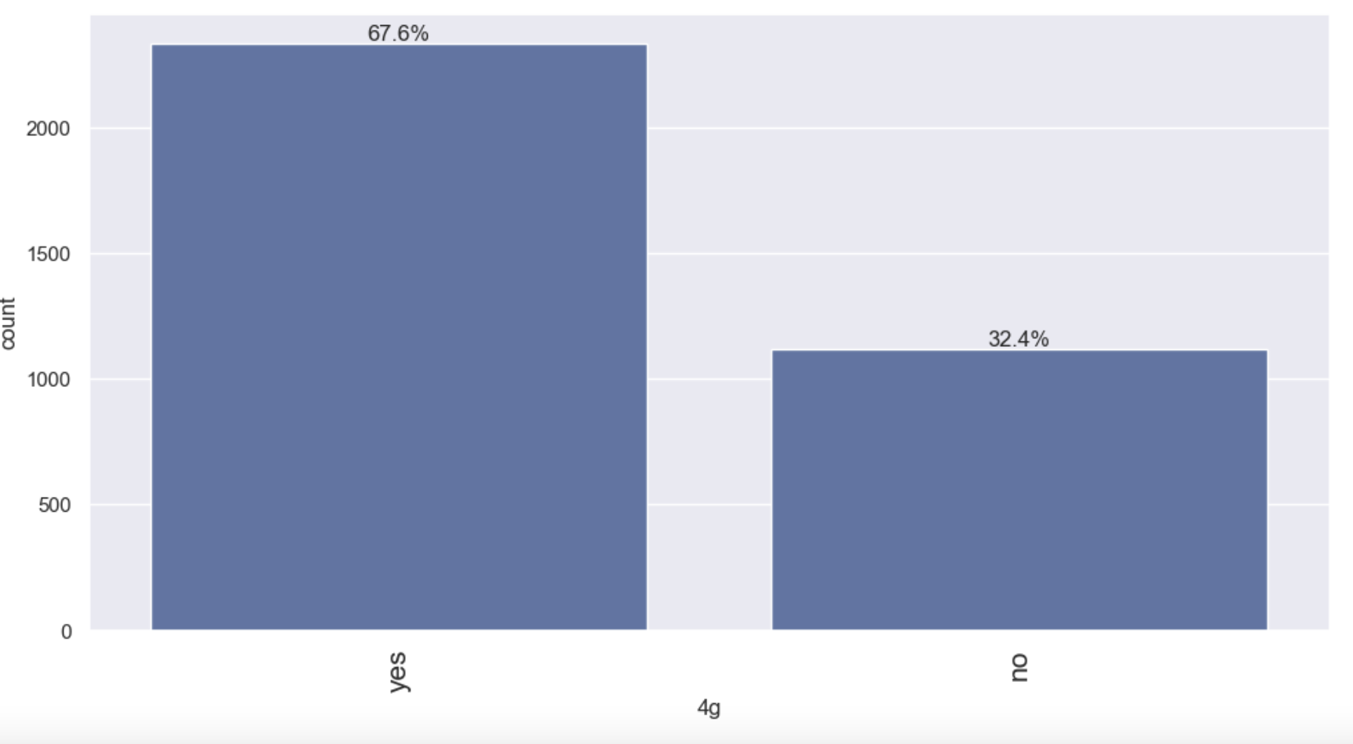
Data Overview, Key Finding and Insights
Majority consumers had 4g phones compared 5g phones
Majority of the phones are from 2014

Slide 8
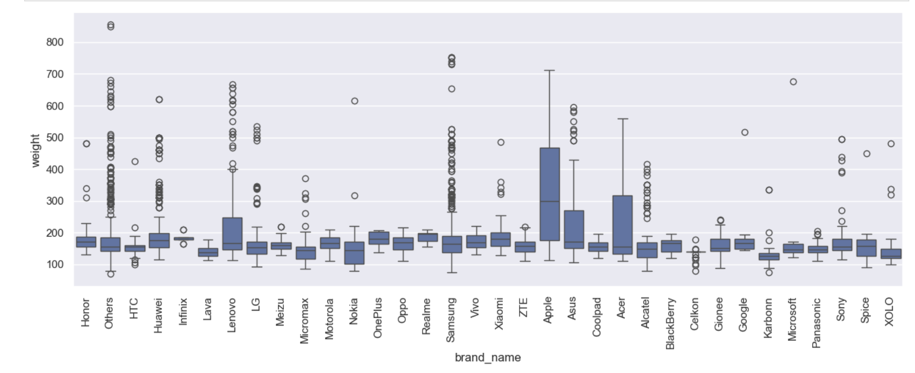
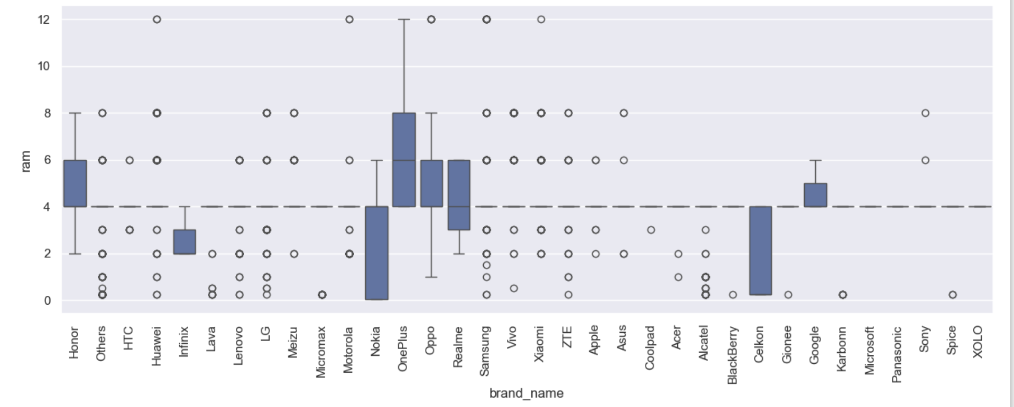
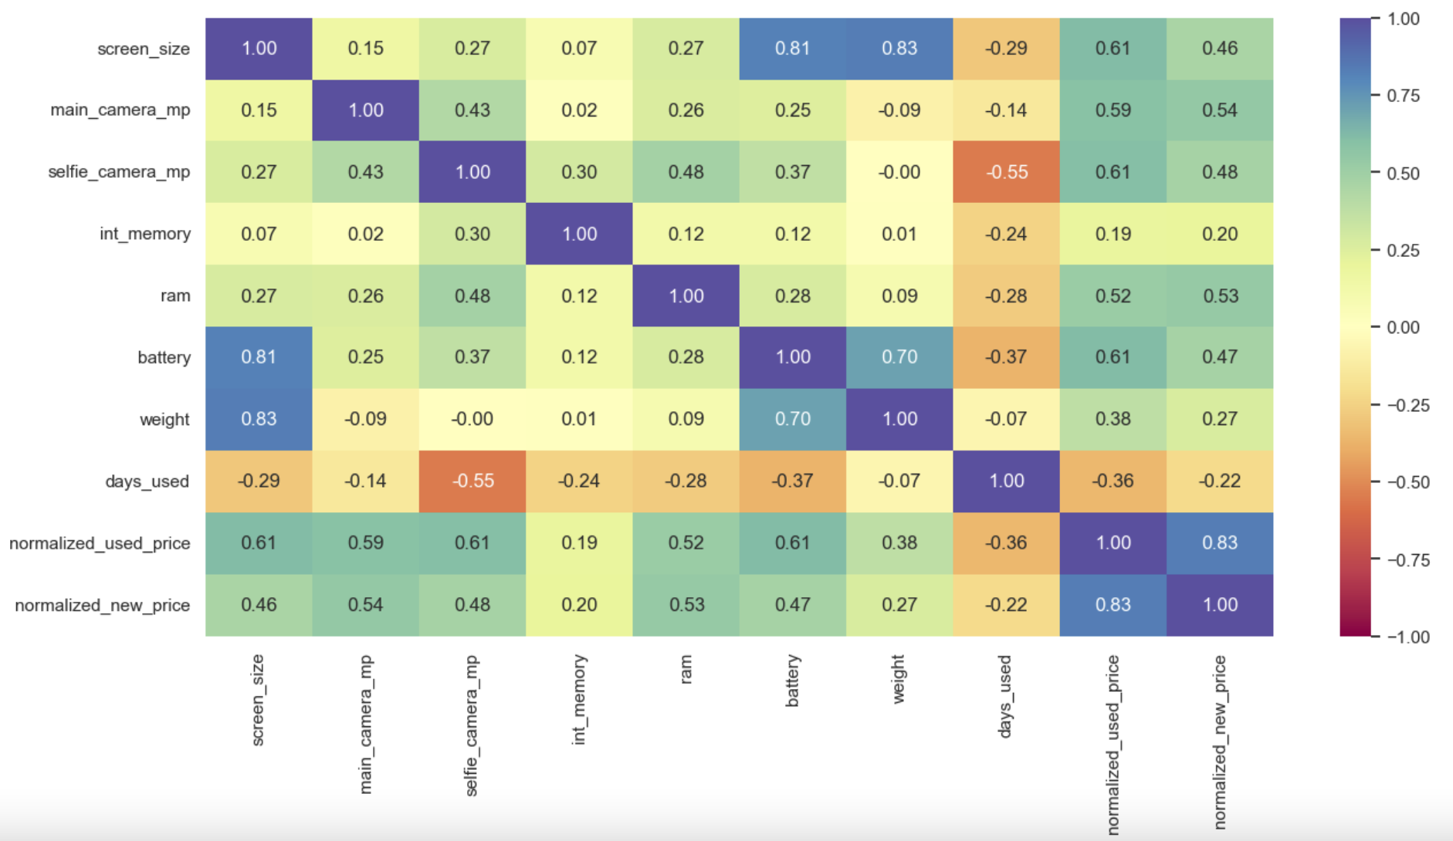
Data Overview, Key Finding and Insights
Weight and Screen Size are highly correlated
Most OnePlus phones have high amount of ram
Most Apple phones are heavier compared to other brands

Slide 9
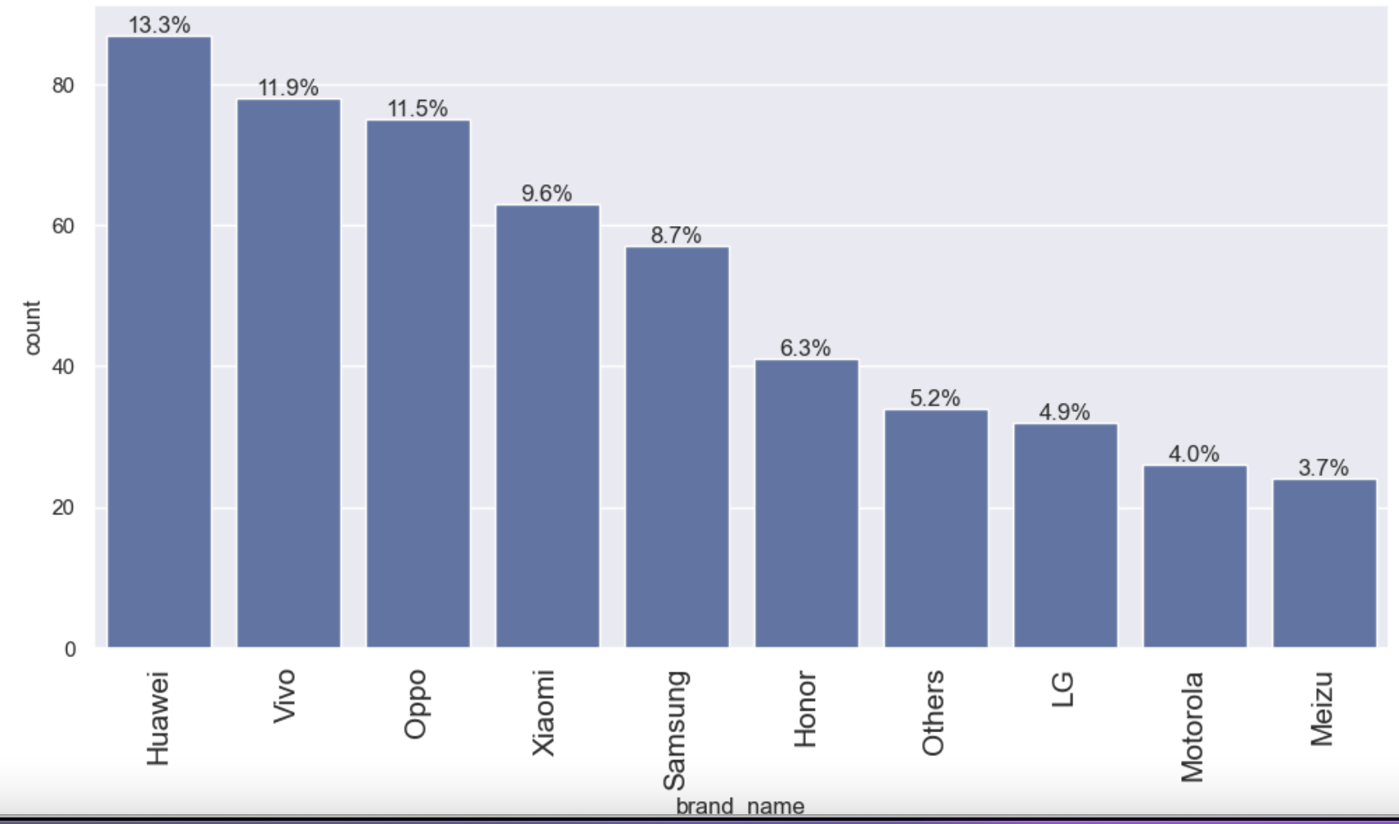
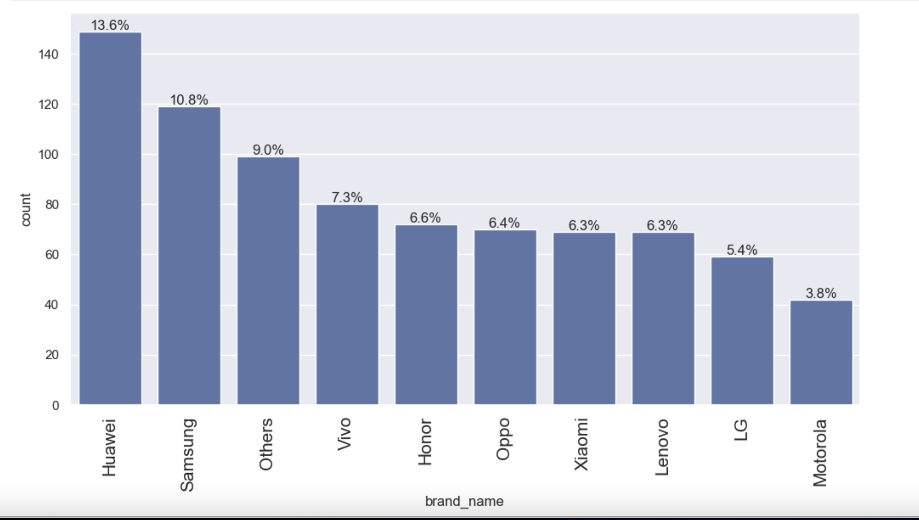
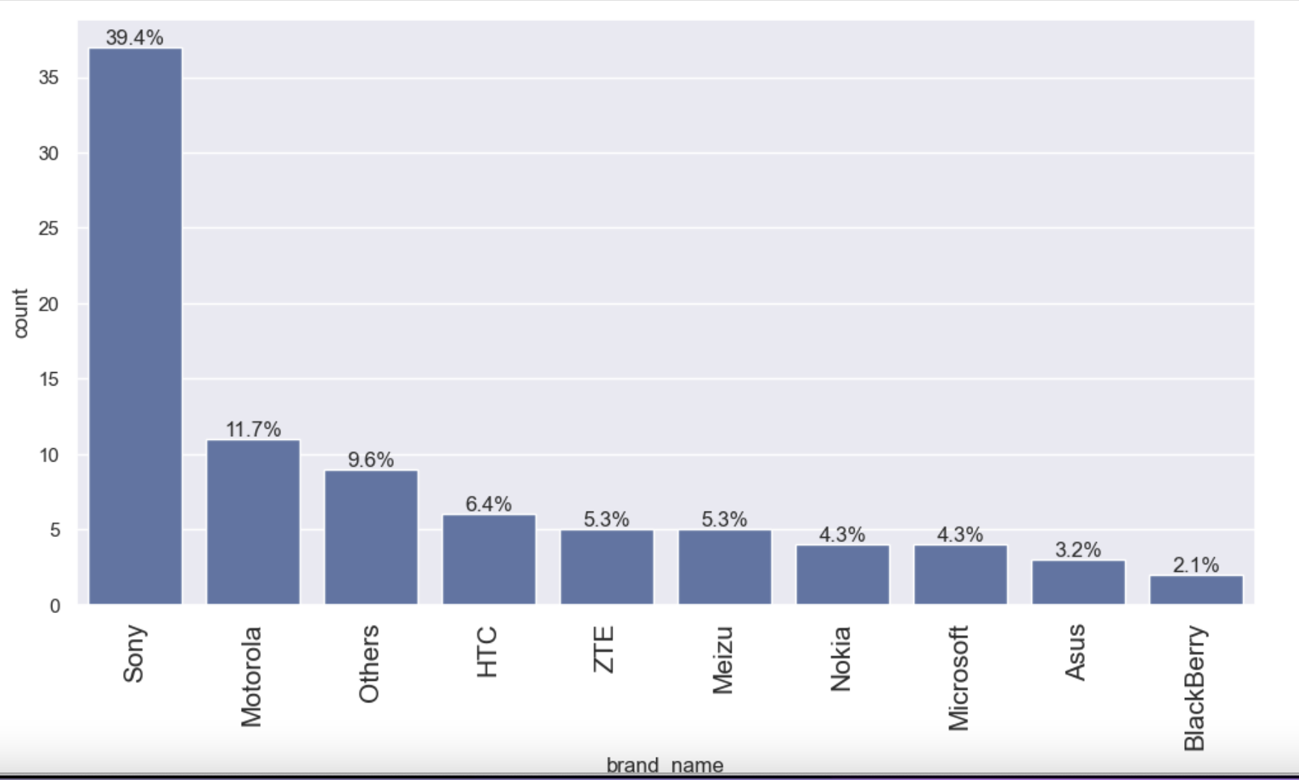
Data Overview, Key Finding and Insights
People who prefer large screen phones Huawei and Samsung are very popular
People who prefer high mega pixel selfie camera phones Huawei and Vivo are most popular
People who prefer high mega pixel main camera Sony is the most popular

Slide 10
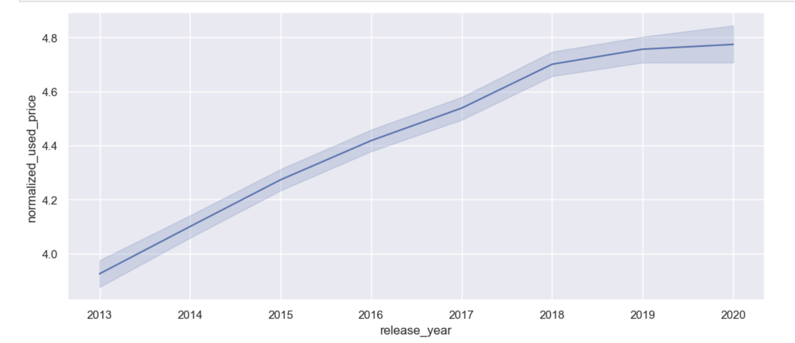
Data Overview, Key Finding and Insights
Normalized used price is very low for older models (2013) to hits a high mark in 2018
Main camera mp data has lots of missing values along with few other data points which we imputed with median values
We created a new column called ‘year since released’ and dropped release year column for better analysis

Slide 11
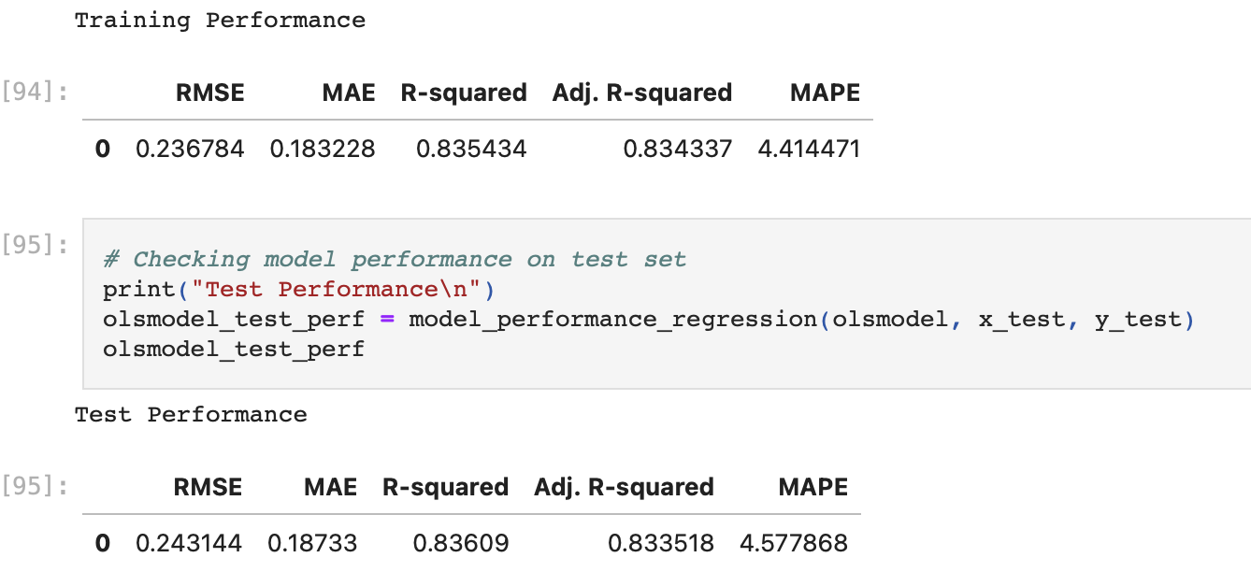
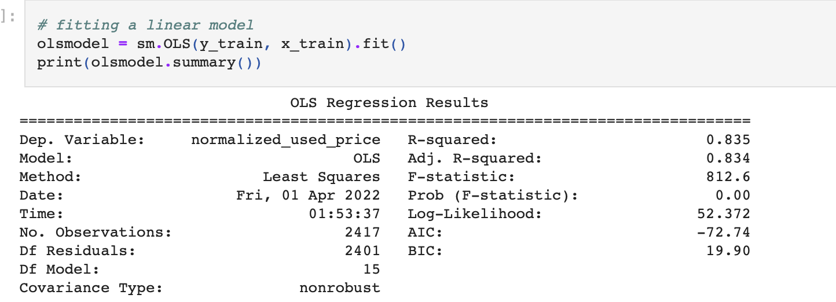
Linear Regression model
We built a linear model and found the r-squared value to be .8
The coefficient of normalized new price is .4
The model is neither overfitting nor underfitting as per RSME of test and train data

Slide 12
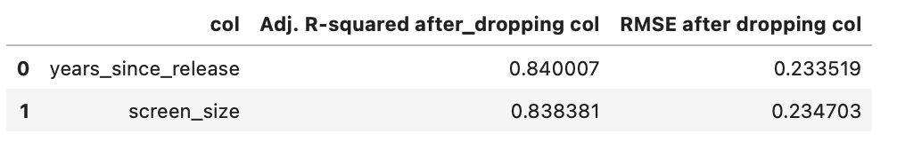
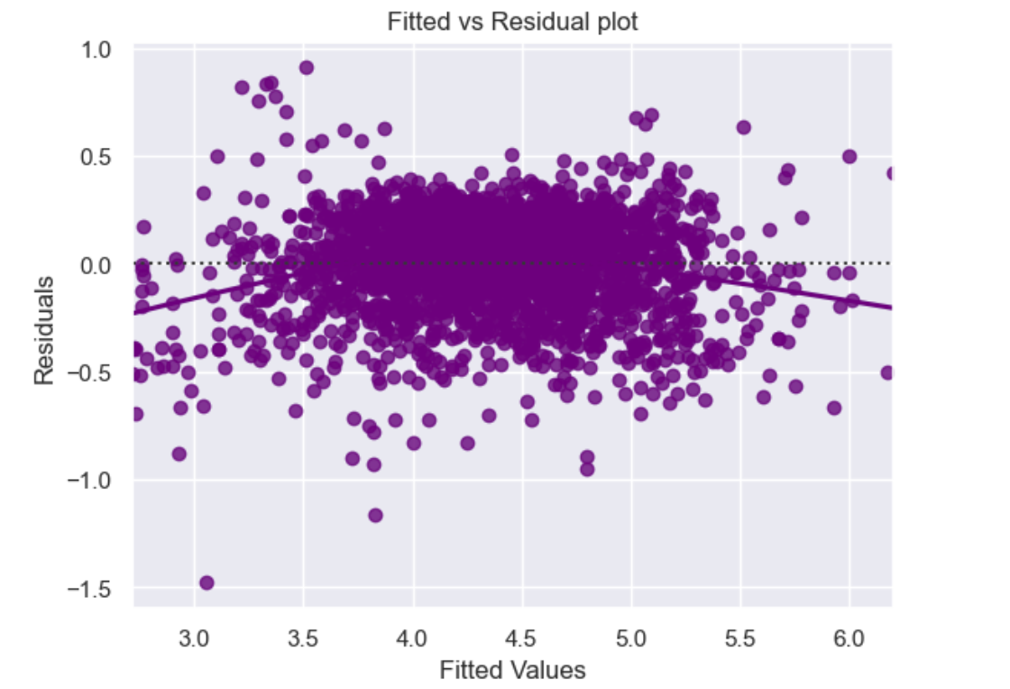
Linear Regression model
Screen size and year since released shown some multicollinearity which we treated
We dropped years since release column to see if that helps and observed the VIF of screen size came below 5
After dropping some high p-values variables we have observed the r-squared remained similar AS .8
Our model can explain 80% variances
We plotted fitted values against residuals and did not see any pattern
So, we can conclude the model is linear and variables as independent

Slide 13
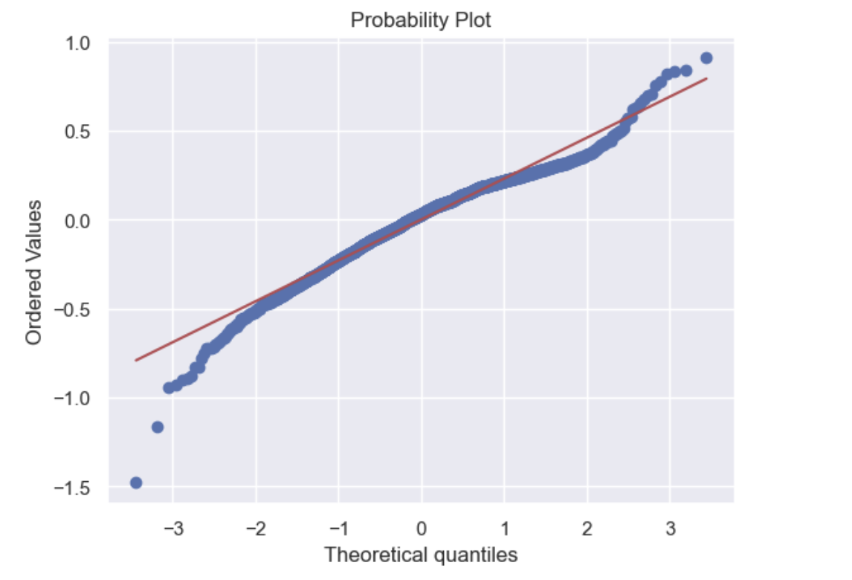
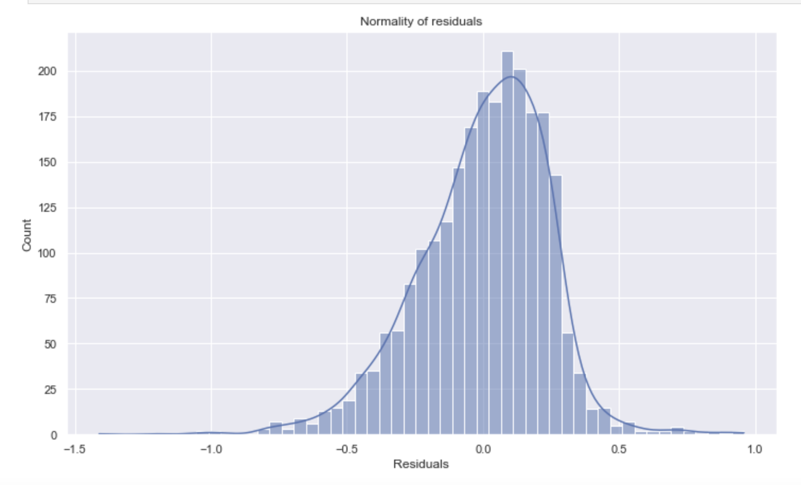
Linear Regression model
As per Normality test of residuals it looks perfect bell shaped
As per QQ plot the residuals follow a straight line
Shapiro’s test result:
ShapiroResult(statistic=0.9711849093437195, pvalue=1.2072848462537407e-21)
Residuals are homoscedastic

Slide 14
Observation and Recommendation
Normalized new price seems like be positively correlated to used price. So, to boost revenue, boost the sales of older models as newer model price are high
Increase of camera size, memory, weight, ram, release year will increase the price of new price as well as used price
Weight and screen size are positively correlated and popular.
Samsung phones with Android OS are best selling phones. Business should offer incentives for other brands to boost sales
4G phones are sold more in used phone market than 5G

Slide 15
Key Takeaway and Benefit of following model
The factors that significantly effect the price of refurbished phones are RAM, screen size, megapixels of front and back camera, memory.
As per model other variables are independent (excluding price).
So, business should focus on selling the refurbished phones that has good memories, screen size, camera megapixel size.
The 4G or 5G factor wont effect much.
Advertise high selling models like Samsung and Huawei.
Attract young buyers with key feature of phones and low selling price.

